Slide 1


Polymers Engineering
Group #5
INFOGRAPHY
Constanza Alvarez-Lopez - A00829469@itesm.mx
Osamu Katagiri-Tanaka - A01212611@itesm.mx
Juan Jesús Rocha-Cuervo - A01752555@itesm.mx
Angel Manuel Villalba-Rodriguez - A00828035@itesm.mx

Slide 2
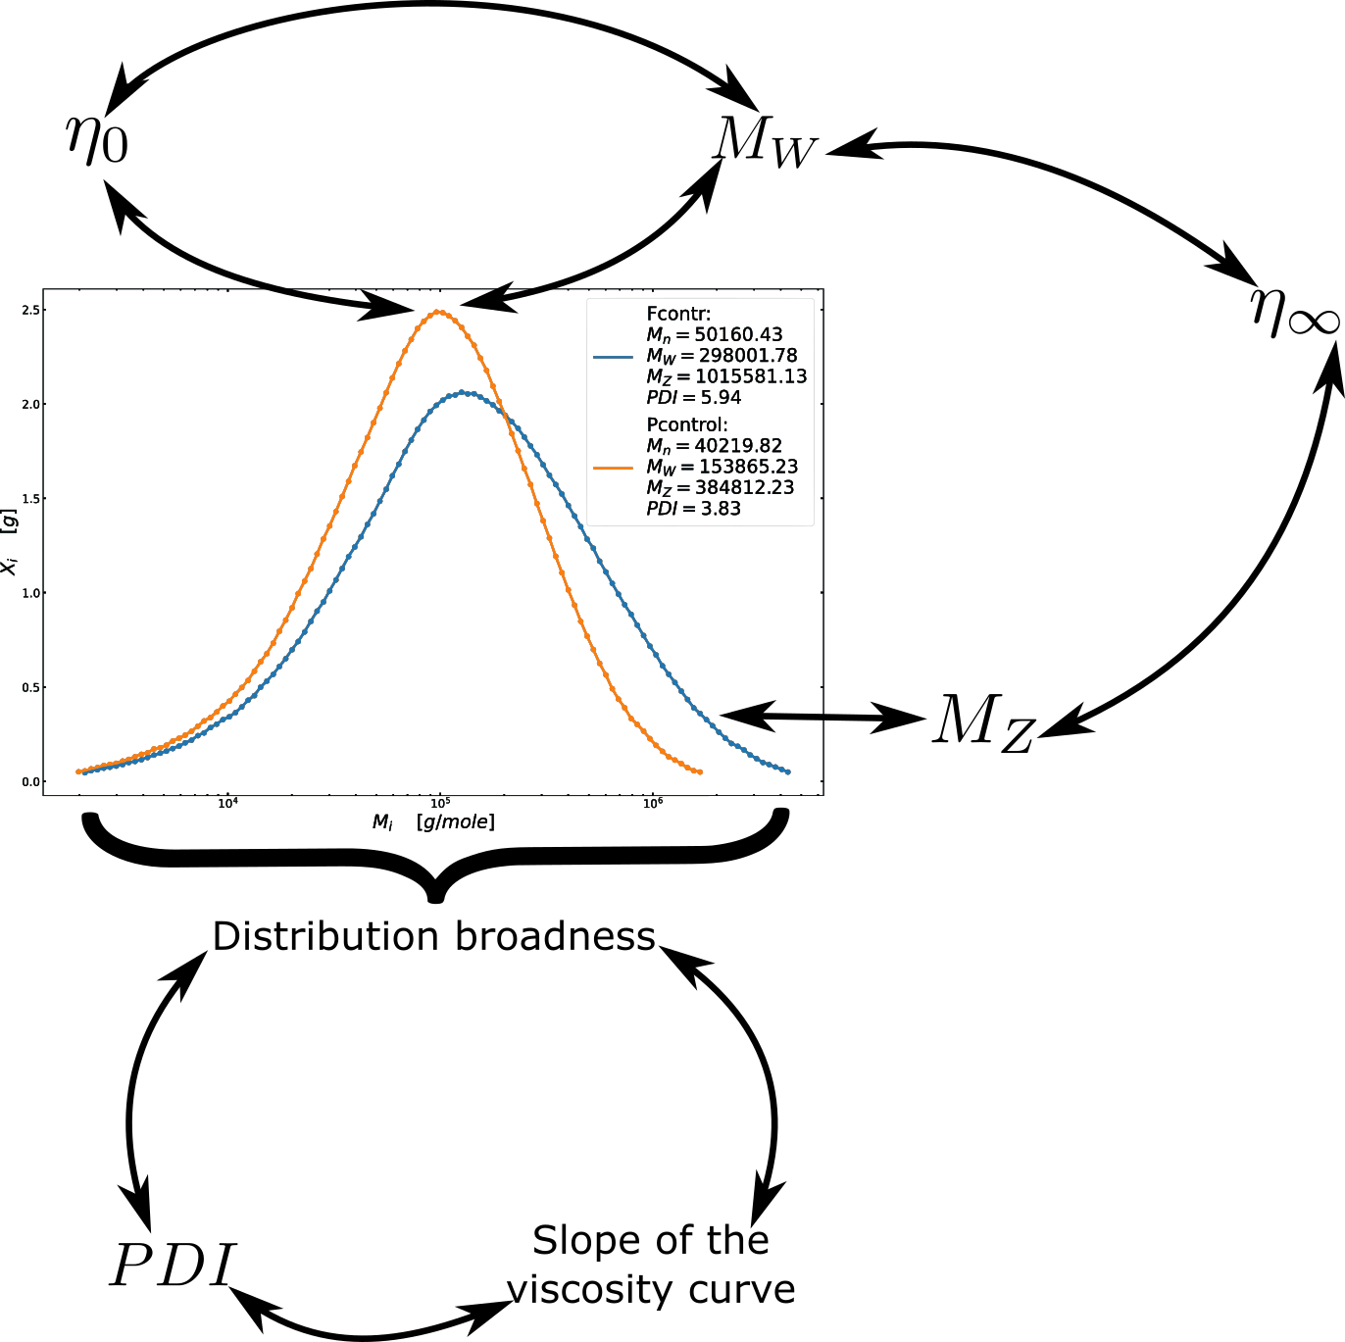
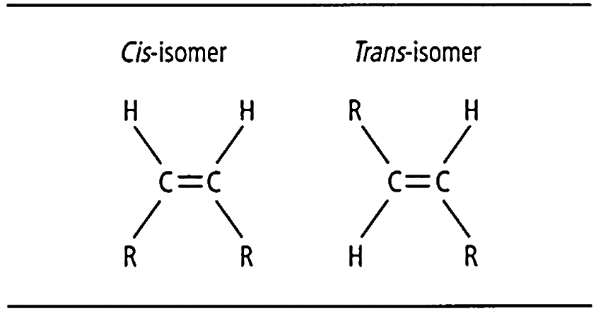

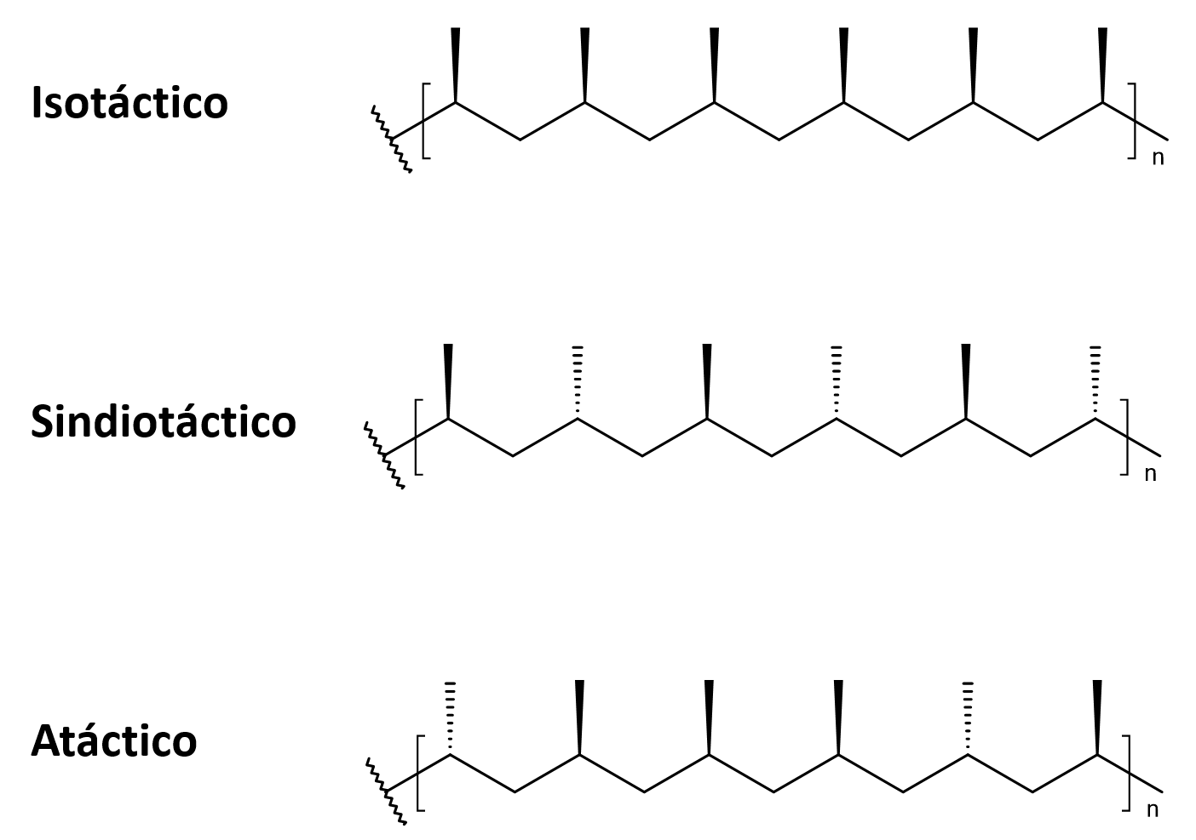
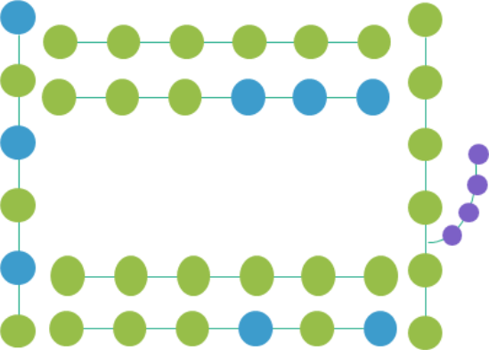
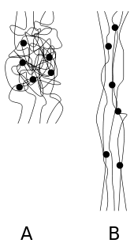
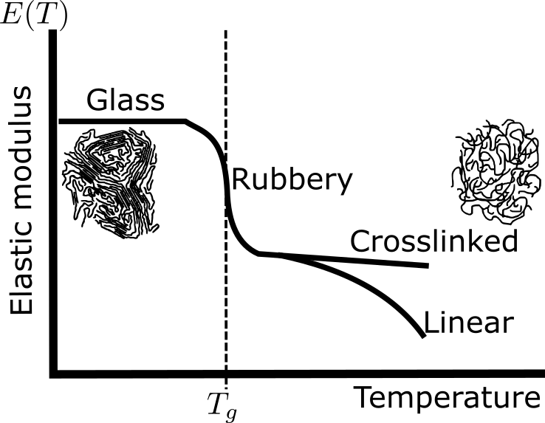






Sample 2
Chemical & Physical Aspects
Mw
>
Zero-shear viscosity
Distribution broadness
>
creep
Polymeric structure
Space
orientation
>
recovery
Tacticity
Chemical
structure
branch size
>
Tg
crosslinks
>
Tg
Distribution broadness
>
PDI
Molecular
forces
>
MFI
Crystallinity
& Steeper slope

Slide 3
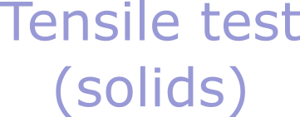
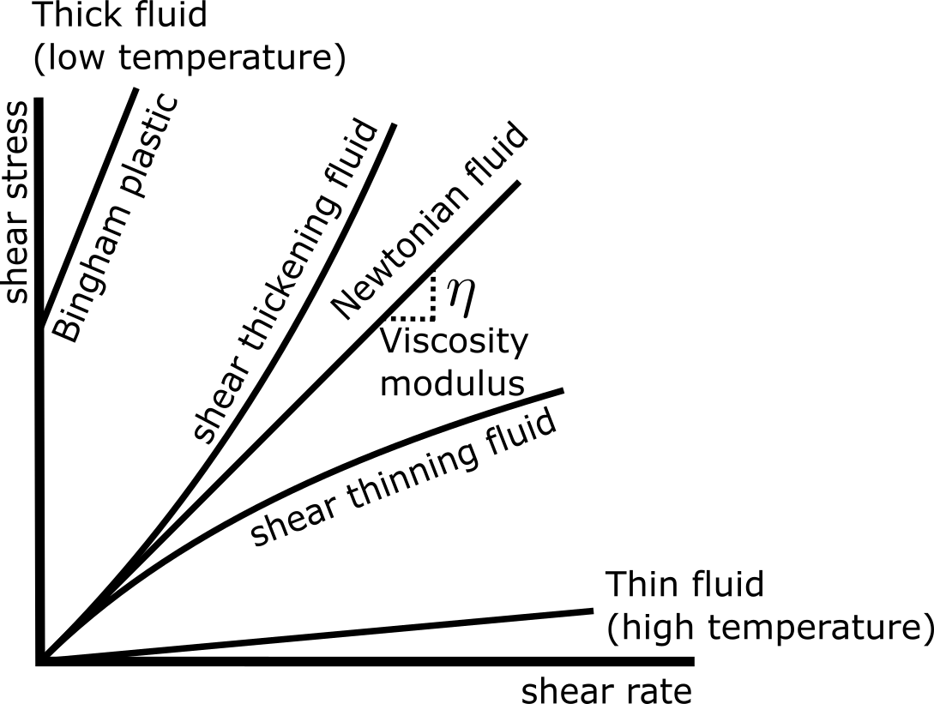


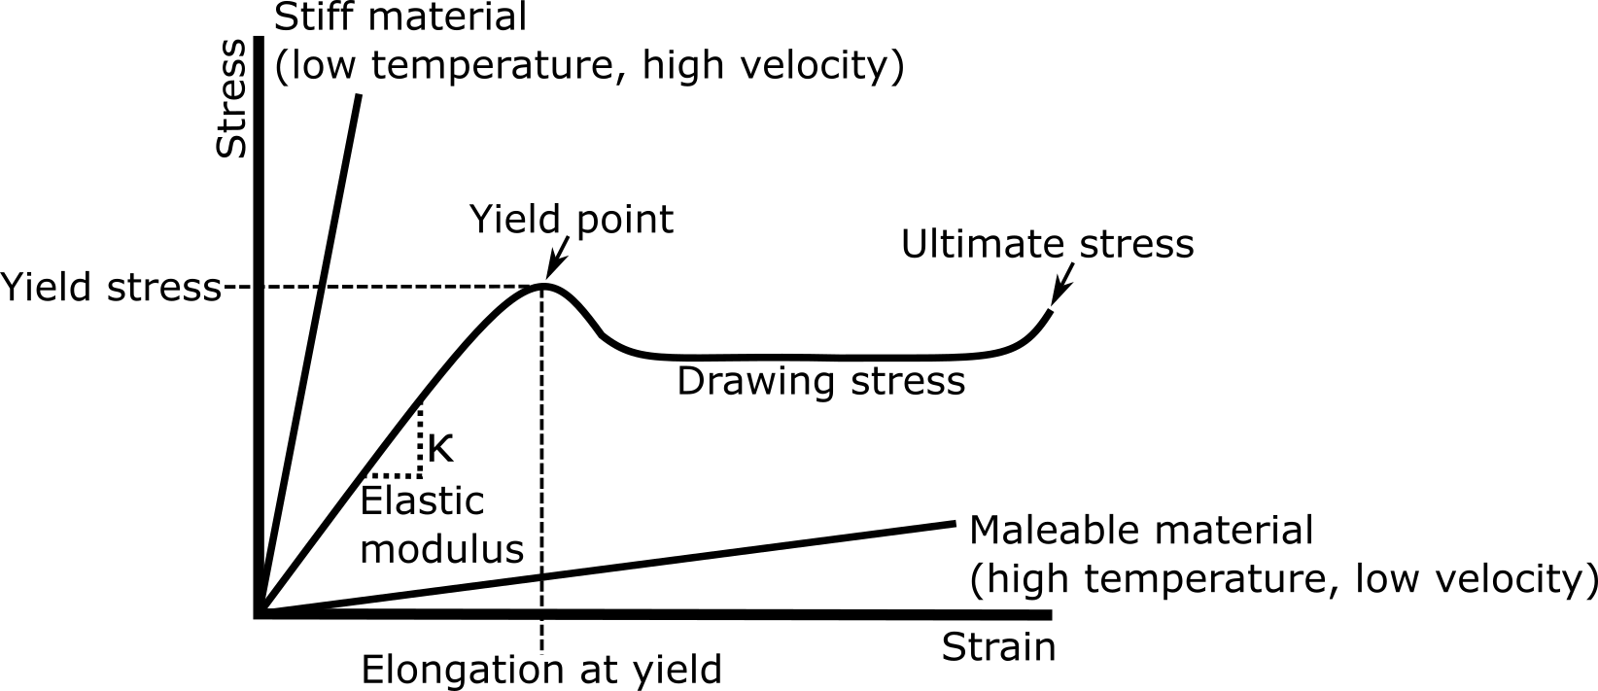
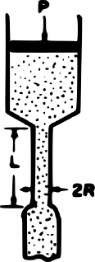
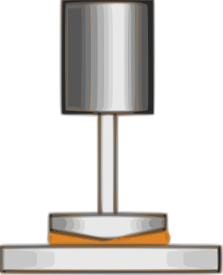
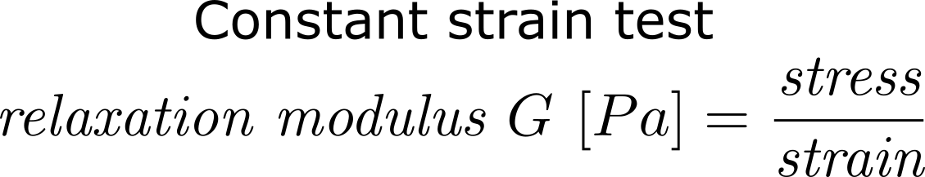
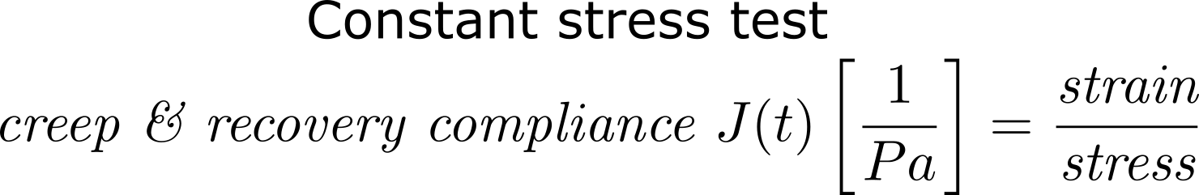
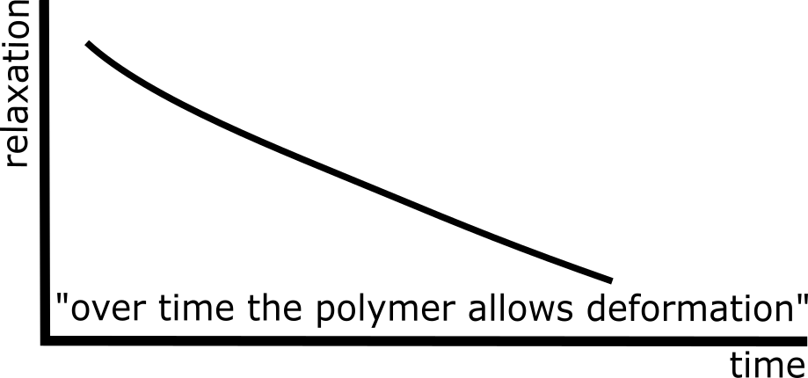
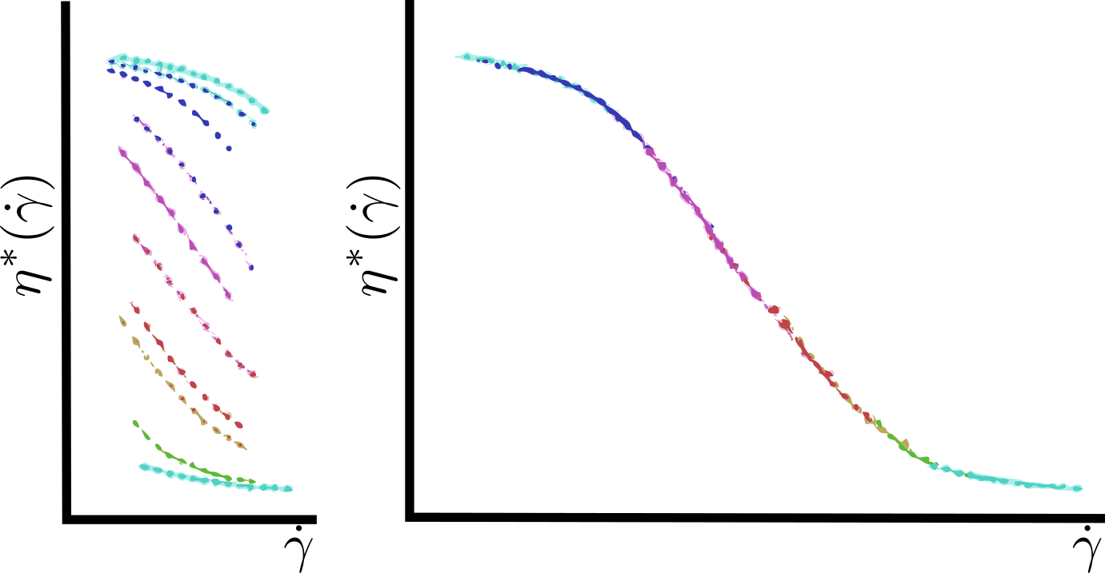
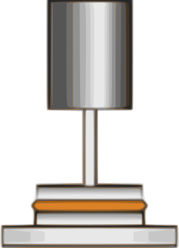
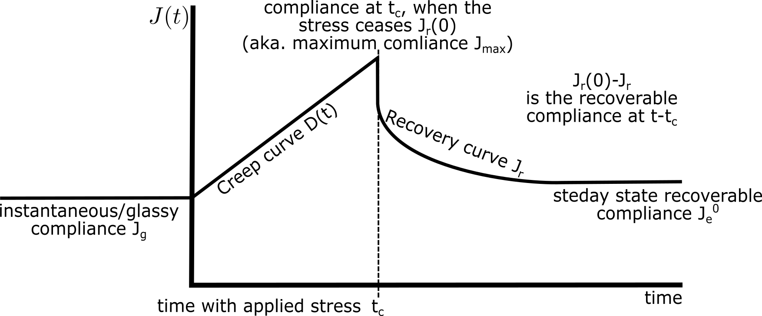


Tips and Tricks (PC and Mac)
Rheology
Complex modulus G* and viscosity η*

Slide 4
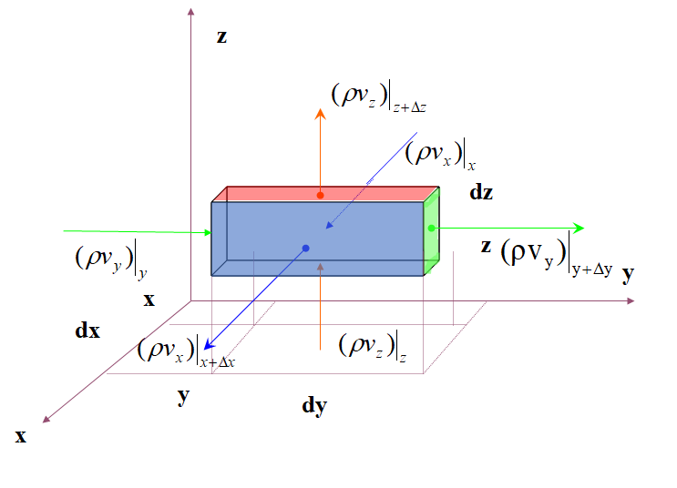
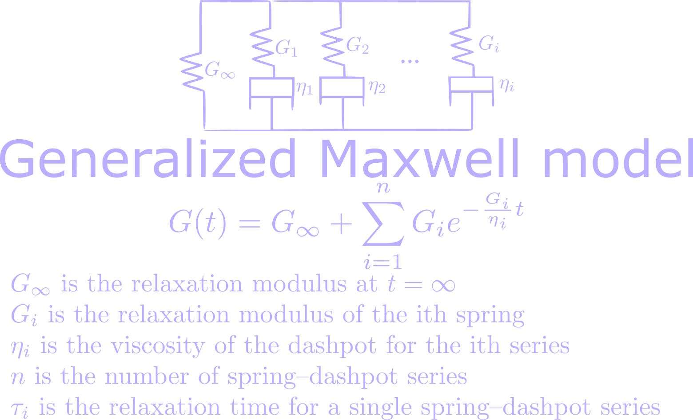
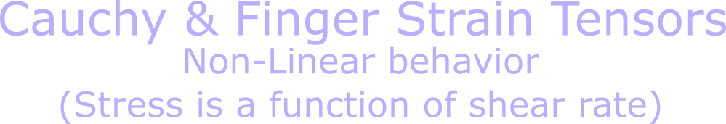




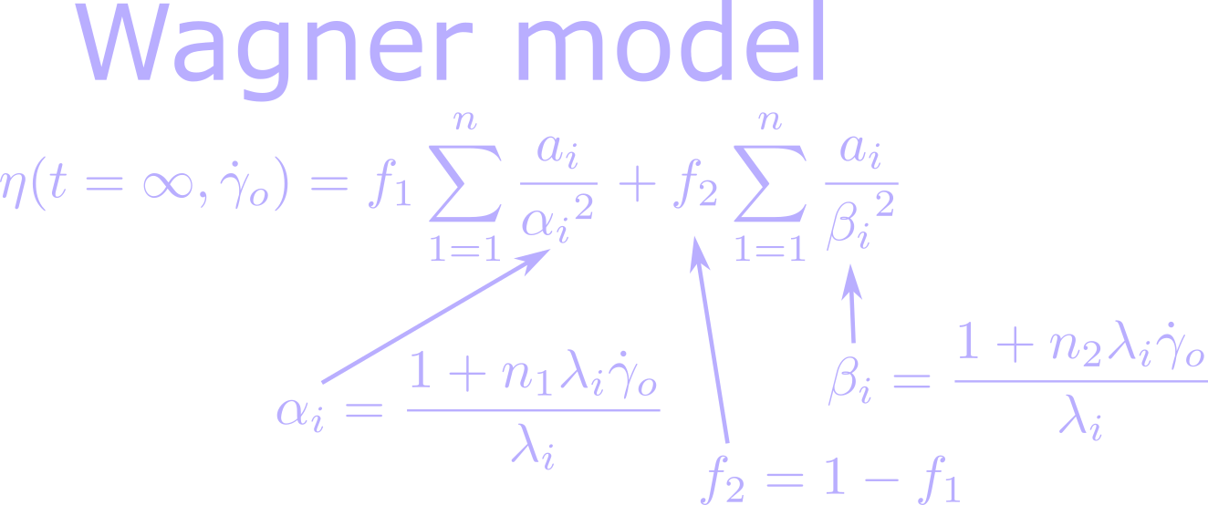

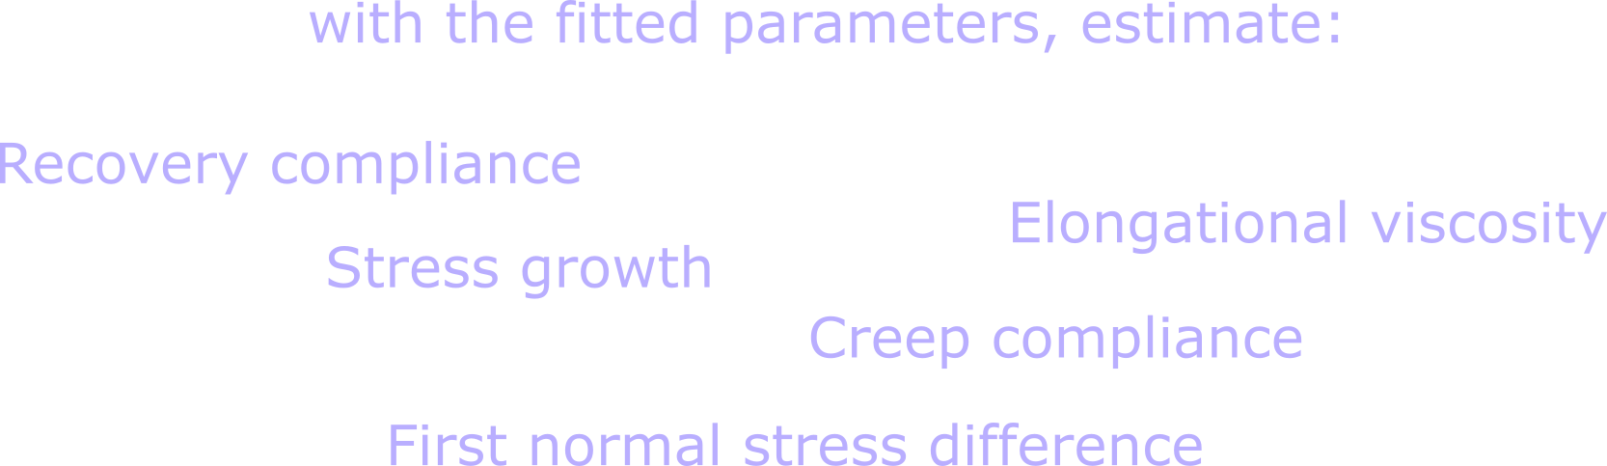
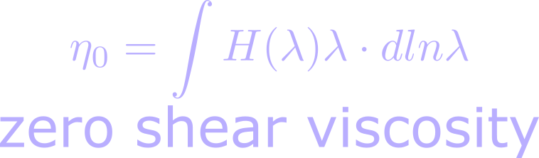

Sample 1
Viscoelastic models

Slide 5
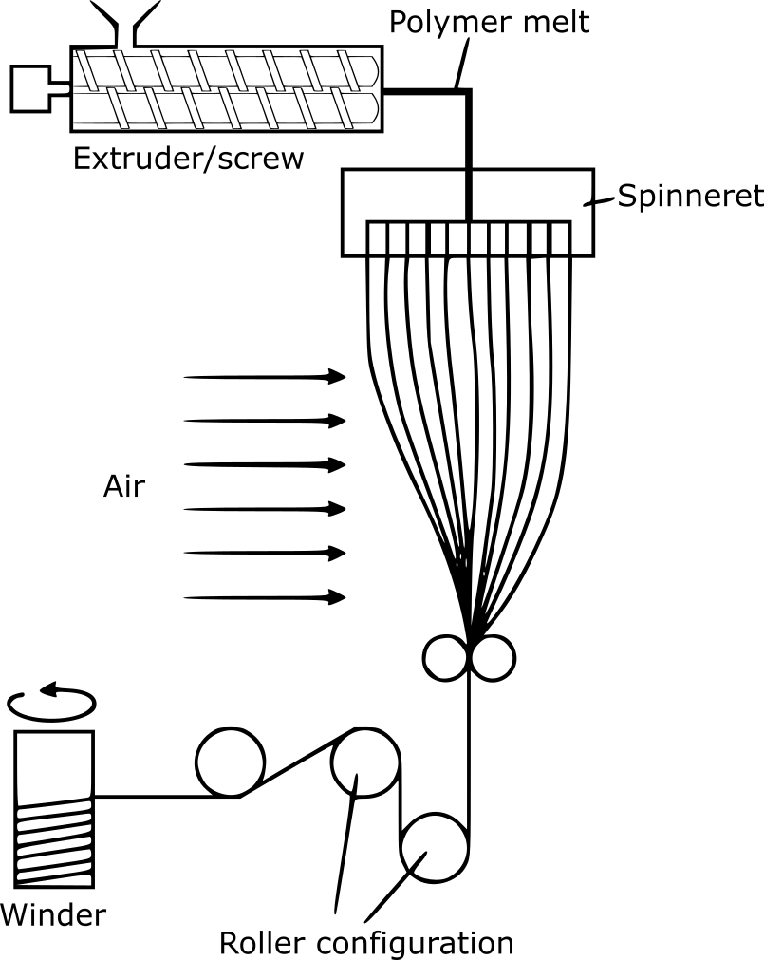
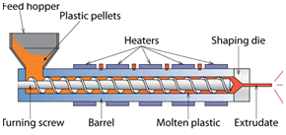
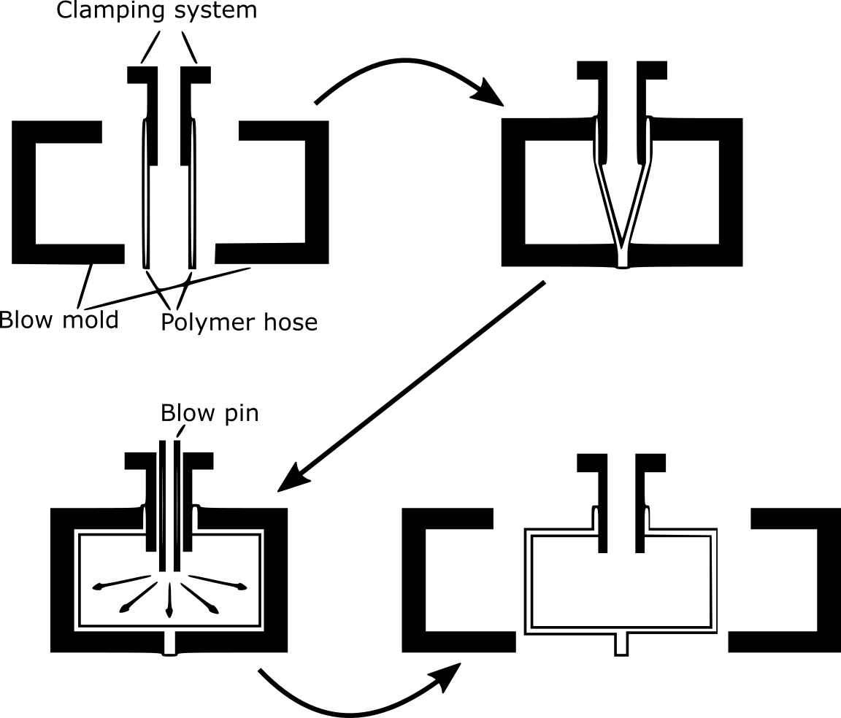
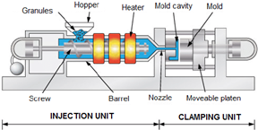
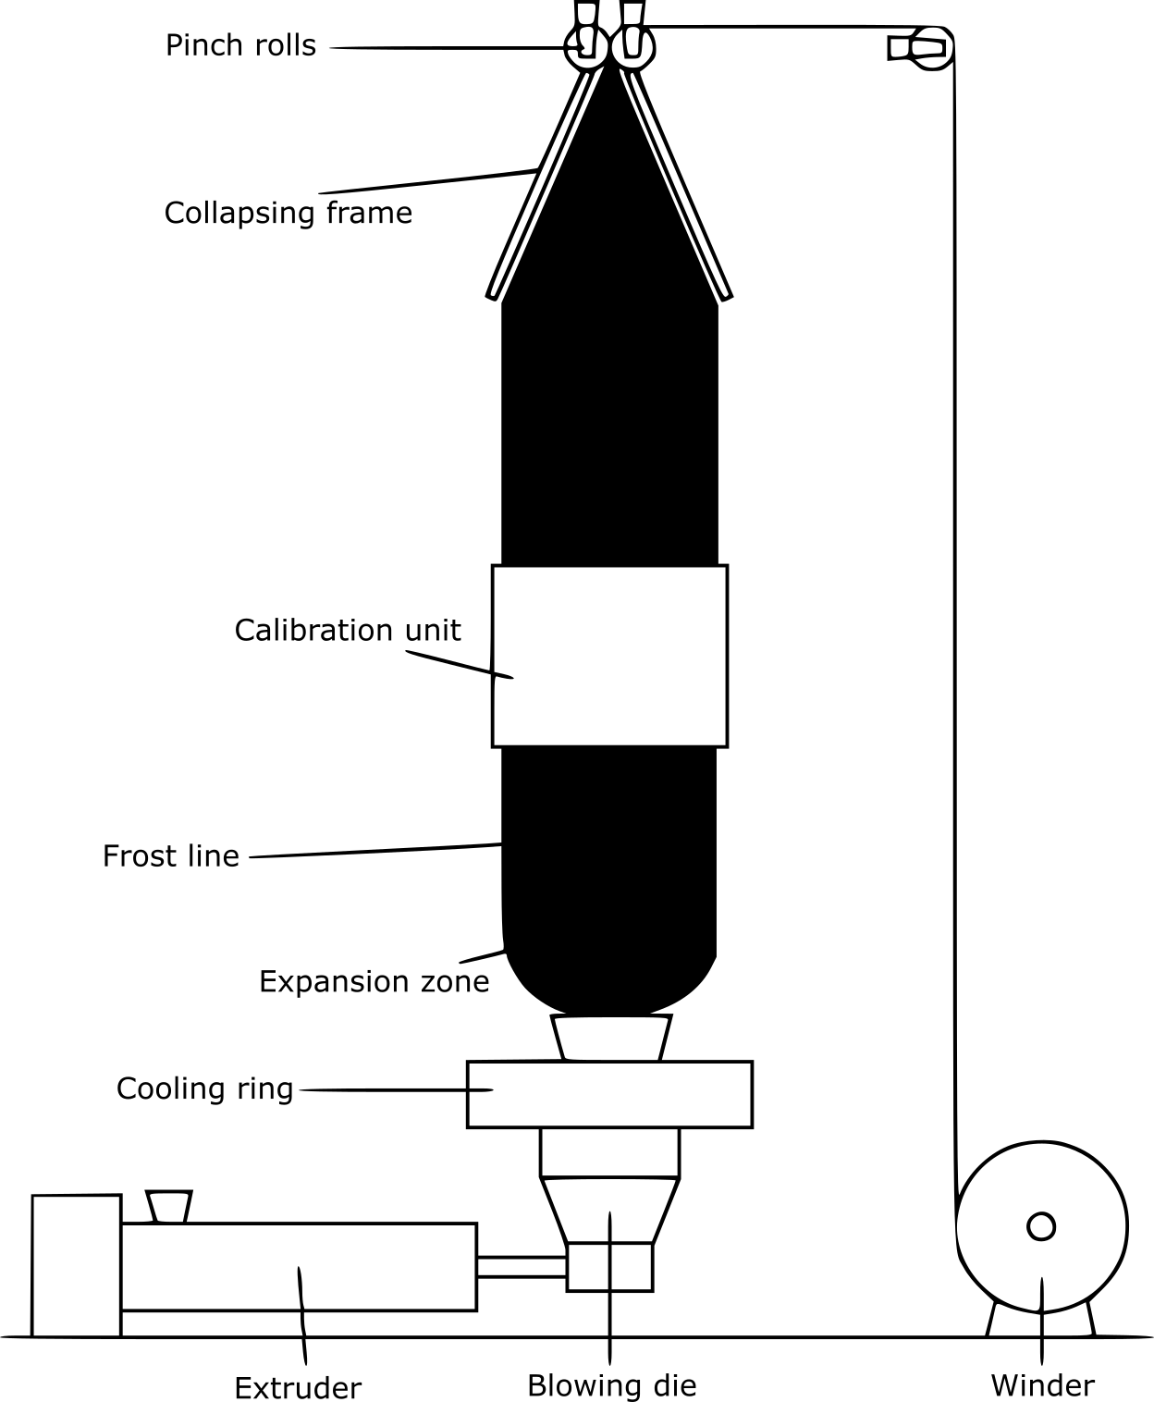



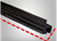
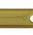


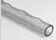




Sample 4
Polymer Processing
die dimensions
Important parameters
Polymer rheology
Extrusion
Cooling conditions
Screw design
Shot size
Barrel temperature
Important parameters
Injection Molding
Lumpy surface
Sink marks
Mold design
Clamping force
Flash
Injection pressure
Defects
Shrinkage
Defects
Jetting
Bubbles
Weld lines
Surging
Pimples
Burn marks
Orange peel
Warpage

Slide 6



